Slide 1

특징
Docker Compose
Multiple isolated environments on a single host
Preserve volume data when containers are created
Only recreate containers that have changed
Variables and moving a composition between environments
Docker Engine
Run Compose apps on K8S(or Swarm) cluster
(참고) https://docs.docker.com/compose/

Slide 2


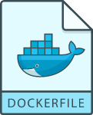
docker-compose.yml overview
Docker Compose
version: "3.7"
services:
db:
image: mysql:8.0.19
restart: always
environment:
- MYSQL_DATABASE=example
- MYSQL_ROOT_PASSWORD=password
app:
build: app
web:
build: web
restart: always
ports:
- 80:80
db
run
app
app
run
build
web
web
run
build
(awesome-compose) https://github.com/docker/awesome-compose

Slide 3
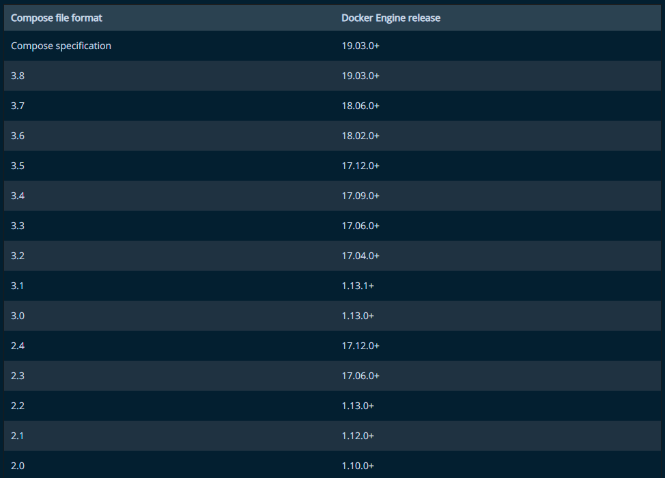
Compose file format vs Docker Engine versions
Docker Compose
version: "3.7"
services:
db:
image: mysql:8.0.19
restart: always
environment:
- MYSQL_DATABASE=example
- MYSQL_ROOT_PASSWORD=password
app:
build: app
web:
build: web
restart: always
ports:
- 80:80
(Compose Specification) https://docs.docker.com/compose/compose-file/

Slide 4
Environment Variables & run
Docker Compose
MYSQL_DATABASE=example
MYSQL_ROOT_PASSWORD=password
version: "3.7"
services:
db:
image: mysql:8.0.19
restart: always
environment:
- MYSQL_DATABASE=${MYSQL_DATABASE}
- MYSQL_ROOT_PASSWORD=${MYSQL_ROOT_PASSWORD}
app:
build: app
web:
build: web
restart: always
ports:
- 80:80
$ docker-compose \
–-env-file=.env \
up -d
.env
docker-compose
(Compose Specification) https://docs.docker.com/compose/compose-file/

Slide 5
Split Environments
Docker Compose
환경 | env file | 설명 | 실행
local | ./config/local.env | 개발 환경 | docker-compose --env-file=./config/local.env
test | ./config/test.env | 테스트 | docker-compose --env-file=./config/test.env
stage | ./config/stage.env | 관련자 확인 | docker-compose --env-file=./config/stage.env
production | ./config/prod.env | 운영 | docker-compose --env-file=./config/prod.env

Slide 6
Simple Application #1
Docker Compose
# WSL(Ubuntu-20.04) docker-k8s-hands-on 디렉토리로 이동
$ cd docker-k8s-hands-on
# awesome-compose/nginx-golang 디렉토리로 이동
$ cd awesome-compose/nginx-golang
# 디렉토리 구성 확인
$ sudo apt install tree
$ tree
.
├── README.md
├── backend
│ ├── Dockerfile
│ └── main.go
├── docker-compose.yml
└── frontend
├── Dockerfile
└── nginx.conf
2 directories, 6 files
# docker-compose 실행
$ docker-compose up –d
# docker container 확인
$ docker ps
…(중략)…
# 브라우저에서 확인
$ curl localhost:80
## .
## ## ## ==
## ## ## ## ## ===
/"""""""""""""""""\___/ ===
{ / ===-
\______ O __/
\ \ __/
\____\_______/
Hello from Docker!
# stop
$ docker-compose down

Slide 7
Simple Application #2
Docker Compose
# WSL(Ubuntu-20.04) docker-k8s-hands-on 디렉토리로 이동
$ cd docker-k8s-hands-on
# awesome-compose/wordpress-mysql 디렉토리로 이동
$ cd awesome-compose/wordpress-mysql
# 디렉토리 구성 확인
$ tree
.
├── README.md
├── docker-compose.yaml
└── output.jpg
0 directories, 3 files
# docker-compose 실행
$ docker-compose up –d
# docker container 확인
$ docker ps
…(중략)…
# 브라우저에서 확인
# stop
$ docker-compose down

Slide 8
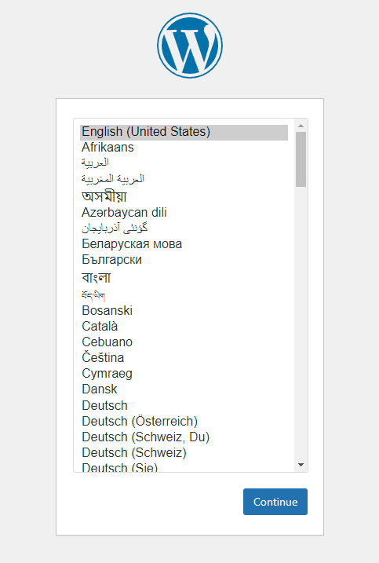
Simple Application #2
Docker Compose

Slide 9
Docker volume mount path(console)
Docker Compose
$ docker inspect wordpress-mysql_db_data
..(중략)…
"Mountpoint": "/var/lib/docker/volumes/wordpress-mysql_db_data/_data",
# 윈도우 wsl (powershell 에서)
PS C:\Users\Public\Documents> cd \\wsl$\docker-desktop-data\version-pack-data\community\docker\volumes\
PS Microsoft.PowerShell.Core\FileSystem::\\wsl$\docker-desktop-data\version-pack-data\community\docker\volumes> dir
디렉터리: \\wsl$\docker-desktop-data\version-pack-data\community\docker\volumes
Mode LastWriteTime Length Name
---- ------------- ------ ----
d----- 2022-01-14 오전 11:09 22106252766b8961e69f994bc0837d93dca3d83a504849b4f54d2f895be8c35d
d----- 2022-01-14 오전 11:09 wordpress-mysql_db_data
-----l 2022-01-13 오후 8:17 0 backingFsBlockDev
------ 2022-01-14 오전 11:09 32768 metadata.db

Slide 10
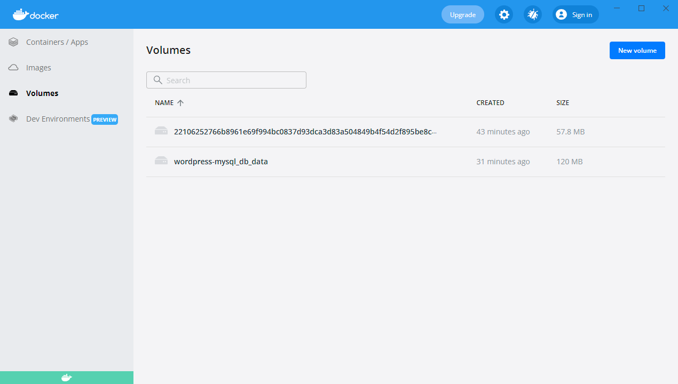
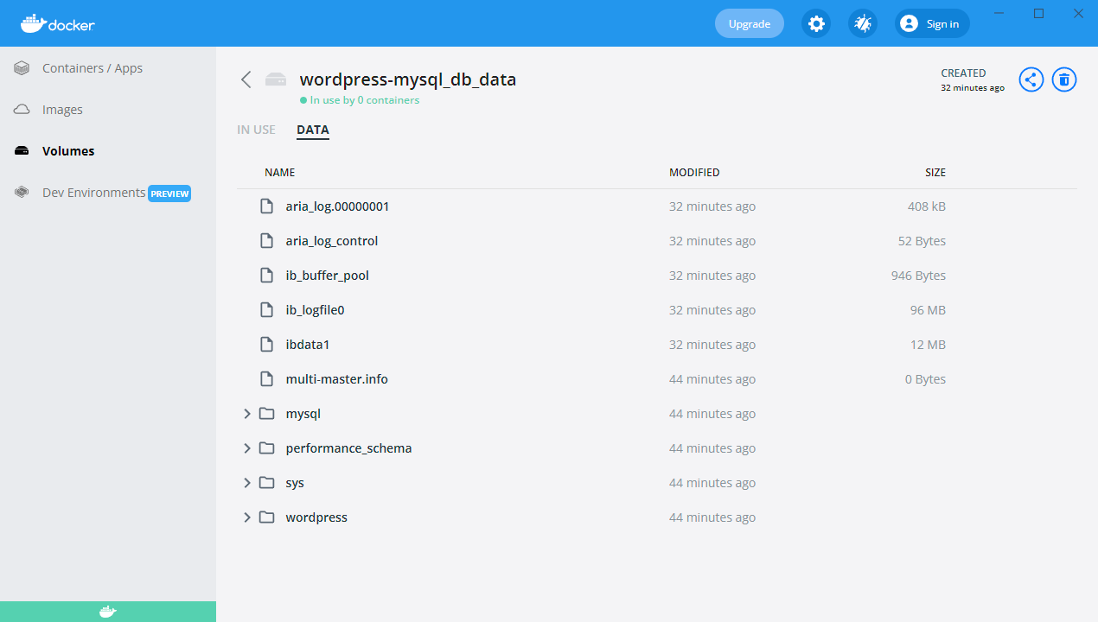
Docker volume mount path(Docker Desktop)
Docker Compose

Slide 11
More references docker compose
Docker Compose
(docker compose 와 버전별 특징) https://meetup.toast.com/posts/277
(docker 및 docker compose 명령어 정리) https://dockerlabs.collabnix.com/docker/cheatsheet/

